Slide 1
Python fundamentals
- Project by Nouman and Krishiv

Slide 2

INDEX
INTRODUCTION TO PYTHON
What is Python ?
Why Python?
Uses of python
Scope of Python
Installing Python IDE
Character Set
Tokens
Functions
Recursions
Rules of Python
Errors in Python
Exceptions in Python

Slide 3
Introduction to python What is python ?
General Purpose Programming Language
High-Level Interpreted Programming Language
Created by Guido Van Rossum in 1991 in Netherlands
Object-Oriented Language

Slide 4

WHY DO PEOPLE USE PYTHON
It's Free(open-source)
Downloading and installing Python is free and easy.
Source code is easily accessible.
It's Easy to Use and Learn
Structure and Syntax of Python Is pretty easy to grasp.
It is simple , readable and adaptable which allows programmers to create code quickly and effectively.
It's Portable
Python runs virtually in every major used today.
Python programs will run in exactly the same manner irrespective of the platform.

Slide 5
USES OF PYTHON
System Programming
GUI Programming
Internet Scripting
Component Integration
Database Programming
Gaming , Images , Robotics and more...

Slide 6
SCOPE OF PYTHON
Science
Bioinformatics
System Administration
Unix
Web logic
Web Sphere
Web Application development
CGI
Testing scripts

Slide 7
INSTALLING PYTHON
Python is pre-installed in most UNIX systems , including Linux and Mac OS X
1
But for in Windows OS users can download python from the below link :
2
https://www.python.org/downloads/
3
From the above link download the latest version of python which is version 3.12.1
After installing python go to start menu and search for python 3.12 or python IDLE and open the application.
4

Slide 8
CHARACTER SET
A character set is a set of valid characters acceptable by a programming language in scripting. In this case, we are talking about the Python programming language. So, the Python character set is a valid set of characters recognized by the Python language. These are the characters we can use during writing a script in Python. Python supports all ASCII / Unicode characters that include:
Alphabets: All capital (A-Z) and small (a-z) alphabets.
Digits: All digits 0-9.
Special Symbols: Python supports all kind of special symbols like, ” ‘ l ; : ! ~ @ # $ % ^ ` & * ( ) _ + – = { } [ ] \ .
White Spaces: White spaces like tab space, blank space, newline, and carriage return.
Other: All ASCII and UNICODE characters are supported by Python that constitutes the Python character set.

Slide 9
PYTHON VARIABLES
A variable in python is a named location that refers to a value which can be used and processed during a program run .
When you assign a value to a variable it will be created as a label pointing to memory location where value is stored .
The dataspace of a variable has defined memory locations and each memory location has it’s owns memory address.

Slide 10
Python comments
What are comments
Comments is python helps in :
Enhance code readability
Documenting the steps and need for a function
Sharing code with fellow developers
There are two type of comments in Python
Single-Line Comments
This comment starts with a # symbol with no whitespaces and lasts till the end of the line
Multi-Line Comments
These comments start with either 3 single quotes (''') or 3 double quotes (""") and ends with the same .
Comments in Python are the lines in the program which are ignored by the interpreter during the execution of the code .

Slide 11
TOKENS IN PYTHON
A token is the smallest individual unit in a python program. All statements and instructions in a program are built with tokens. The various tokens in python are :
Keywords
Identifiers
Literals
Operators
Punctuators

Slide 12
KEYWORDS
False | Assert | del | for | in | or | while
None | Break | elif | from | is | pass | with
True | class | else | global | lambda | raise | yield
and | continue | except | if | nonlocal | return | async
as | def | finally | import | Not | try | await
Keywords are the reserved words that cannot be used as a identifier in python.
Keywords are case – sensitive

Slide 13
IDENTIFIERS
Identifiers are names given to class , functions , variables etc. in python
The following are the rules for writing identifiers :
Can be a combination of letters of lowercase (a to z) to upper (A to Z)
or digits (0 to 9) or an underscore(_) .
An Identifier cannot start with a digit .
Keywords cannot be used as Identifiers .
Cannot use special symbols like ! , @ , # , $ , % etc. In our Identifier
Can be of any length

Slide 14
Literals
Literals or constant values are the raw data given to a variable or constant which has a fixed value
In Python there are various types of Literals :
Numeric Literals
String Literals
Boolean Literals
Special Literals (None)
Literal Collections

Slide 15
Numeric literals
There are 3 types of Numeric Literals in Python :
Integer Literals
Binary Literals
(Ex: a = 01010)
Decimal literals
(Ex: b = 102)
Octal literals
(Ex: c = 0o310)
Hexadecimal literals
(Ex: d = 0e12c)
Float Literals
(Ex: Float1=1.5)
Complex Literals
(Ex: C=3.14j)

Slide 16
String literals
The text enclosed in single/double quotes forms a string literal in Python .
There are two string types in python :
Single-line Strings
Text which is enclosed in single/double quotes and terminates in one line
Ex : Text1 = 'hello'
Multi-line Strings
Size of Strings
Python determines the size of a string as count of the characters in it .
But if your string literal has escape sequence count it as one character

Slide 17
BOOLEAN LITERALS
A Boolean literal is used to represent one of the two Boolean values which
Is True or False .
A Boolean literal can be either True or False
The following is an example of using Boolean literal :
X=(1==True) SAMPLE OUTPUT
Y=(1==False) X is : True
A=True + 4 Y is : False
B=False+10 5
Print(a , b) 10

Slide 18
Special literal (NONE)
The None literal is used to indicate the absence of value .
It is also used to indicate the end of lists in Python.
It will always return False

Slide 19
LITERAL COLLECTIONS
There are 4 types of Literal Collections
Lists
It is represented by two closed brackets []
Ex:[1,2,3]
Sets
Sets are a collection of unique elements
Sets are represented in two curly brackets
It has three different operations - (I) Union , (II) Intersection , (III) Difference
Ex:{1,2,3}
Tuples
Tuples are immutable
It is represented by two open brackets ()
Ex: (1,2,3)
Dictionaries
Dictionaries are mutable datatype which has a key-value pairing .
It is represented by two curly brackets { } in which the elements for example placed like {A:1,B:2} where A and B are keys and 1 and 2 their respective values

Slide 20
OPERATORS
Operators are special symbols in Python that carry out arithmetic or logical computation .
The value that operator operates on is called "Operand" .
There are 8 types :
Arithmetic Operators
Comparision Operators
Logical Operators
Bitwise Operators
Assignment Operators
Special Operators
Identity Operators
Membership Operators

Slide 21
Arithmetic operators
OPERATOR | MEANING | EXAMPLE
+ | Add two operands or unary plus | X+Y+2
- | Subtract right operand from the left or unary minus | X-Y-2
* | Multiply two operands | X*Y
/ | Divide left operand by the right one (results in float) | X/Y
% | Modulus – Remainder of the division from left operand by right | X%Y
// | Floor division – Results in whole no | X//Y
** | Exponent – left operant raised to power right | X**Y

Slide 22
Comparision operators
OPERATOR | MEANING | EXAMPLE
> | Greater than – True if left operand greater than right | X>Y
< | Less than – True if left operand less than right | X<Y
== | Equal to – True if both operands are equal | X == Y
!= | Not equal to – True if operands are not equal | X != Y
>= | Greater than equal to – True if left operand is greater than equal to right operand | X>=Y
<= | Less than equal to – True if left operand is less than equal to right operand | X<=y

Slide 23
LOGICAL OPERATORS
OPERATOR | MEANING | EXAMPLE
and | True if both the operands are true | X and Y
or | True if either of the operands is true | X or Y
not | True if operand is False | not x

Slide 24
BITWISE OPERATORS
Bitwise operators act on operands as if they were string of binary digits
It operates bit by bit
Following are the bitwise operators :
OPERATOR | MEANING | EXAMPLE
& | Bitwise AND | X & Y = 0 (0000 0000)
| | Bitwise OR | X | Y = 14 (0000 1110)
~ | Bitwise NOT | ~X = -11 (1111 0101)
^ | Bitwise XOR | X^Y = 14 (0000 1110)
>> | Bitwise right shift | X>>2 = 2 (0000 0010)
<< | Bitwise left shift | X<<2 = 40 (0010 1000)

Slide 25
ASSIGNMENT Operators
Assignment operators are used in python to assign values to variables.
The following are the types of Assignment Operators
OPERATORS | OPERATORS | OPERATORS
= | **= | //=
+= | &=
-= | |=
*= | ^=
/= | >>=
%= | <<=

Slide 26
SPECIAL OPERATORS
Identity Operators
Membership Operators
OPERATOR | MEANING | EXAMPLE
is | True if the operands are identical | X is True
is not | True if the operands are not identical | X is not true
OPERATOR | MEANING | EXAMPLE
in | True if value/variable found in sequence | X is True
not in | True if value/variable not found in sequence | X is not true

Slide 27
Punctuators
Punctuators are the symbols used in python to organize the structures , statements and expressions
The following are the punctuators used in python
PUNCTUATOR | DEFINITION | EXAMPLE
[]
{}
()
@
-=
+=
*=
//=
**==

Slide 28
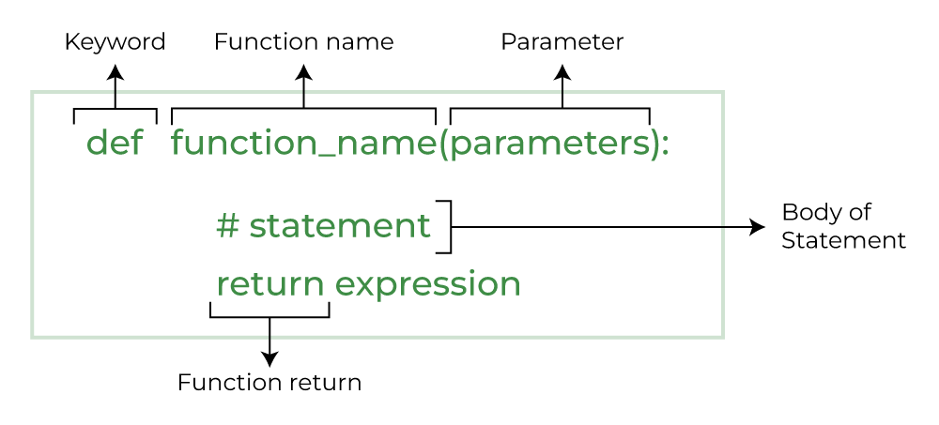
Functions in python
Python functions are a block of statements that return a specific task .
Benefits of using functions in python are :
Increase code readability
Increase code reusability
The common syntax to declare a function is as follows :

Slide 29

Using a function in python
To create a function we use the def keyword -->
After creating a function we can call it at the end by using the name of the function followed by parentheses containing parameters of the function .
Arguments are the values passed inside the parentheses of the function . A function can have any number of arguments separated by a comma .
A function can also be inside of another function these are known as nested functions .
Return statement is used in a function to exit from a function and return the desired value or data item to the caller .

Slide 30
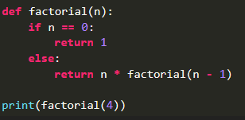
Recursive functions
Recursion in python occurs when a function calls itself .
A Recursive function can become a non-terminating loop so it is better to check the exit statement while creating it .
The below given program is a simple recursive function to calculate the factorial of a number .

Slide 31
RULES OF PYTHON
To represent a statement in python , newline(statement) is used.
Use of semicolon at the end of statement is optional.
Indentations (four spaces) are used to represent block of codes.
To run a program in python the shortcut F5 key is used .
Python is a case - sensitive language .
Keywords cannot be used as identifiers

Slide 32
ERRORS IN PYTHON
Errors are the problems in a program due to which the program will stop the execution . On the other hand , exceptions are raised when some internal events occur which changes the normal flow of the program .
There are two major types of error which occurs in Python :
Syntax errors
This occurs when the proper syntax of the language is not followed which therefore leads to a syntax error .
Logical errors
These errors are not encountered during a compile – time or run – time but it does not give the proper output because of the mistake in logic of he/she program

Slide 33
Exceptions in python
Exceptions | Description
EOFError | Raised when one of the built-in functions hits and EOF(end-of-file) condition
IOError | Raised when an I/O operation(print) fails for an I/O related reason (file not found)
Name Error | Raised when an identifier name is not found
Index Error | Raised when a sequence subscript or index is out of range
Import Error | Raised when an import statement fails to find the module definition
Type Error | Raised when an operation or function is applied to an object of inappropriate type
ZeroDivision | Raised when a built-in operation or function receives an argument with an inappropriate value
Overflow | Raised when the result of an arithmetic operation is too large to be represented
Key Error | Raised when a mapping (dictionary) key is not found in set of existing keys
Exception refers to any irregular situation occurring during execution runtime which you have no control on .
There are 10 built-in exceptions in python :

Slide 34

THANK YOU !
- From Krishiv and Nouman

